Slide 1
UNIX Programming(18CS56) Module 4
Changing User IDs and Group IDs, Interpreter Files, system Function, Process Accounting, User Identification, Process Times, I/O Redirection.
Overview of IPC Methods, Pipes, popen, pclose Functions, Coprocesses, FIFOs, System V IPC, Message Queues, Semaphores.
Shared Memory, Client-Server Properties, Stream Pipes, Passing File Descriptors, An Open Server-Version 1, Client-Server Connection Functions.

Slide 2
CHANGING USER IDs AND GROUP IDs
When our programs need additional privileges or need to gain access to resources that they currently aren't allowed to access, they need to change their user or group ID to an ID that has the appropriate privilege or access.
Similarly, when our programs need to lower their privileges or prevent access to certain resources, they do so by changing either their user ID or group ID to an ID without the privilege or ability access to the resource.

Slide 3
Both return: 0 if OK, 1 on error
There are rules for who can change the IDs. Let's consider only the user ID for now. (Everything we describe for the user ID also applies to the group ID.)
If the process has superuser privileges, the setuid function sets the real user ID, effective user ID, and saved set-user-ID to uid.
If the process does not have superuser privileges, but uid equals either the real user ID or the saved set-user-ID, setuid sets only the effective user ID to uid. The real user ID and the saved set-user-ID are not changed.
If neither of these two conditions is true, errno is set to EPERM, and 1 is returned.

Slide 4
We can make a few statements about the three user IDs that the kernel maintains.
Only a superuser process can change the real user ID. Normally, the real user ID is set by the login(1) program when we log in and never changes. Because login is a superuser process, it sets all three user IDs when it calls setuid.
The effective user ID is set by the exec functions only if the set-user-ID bit is set for the program file. If the set-user-ID bit is not set, the exec functions leave the effective user ID as its current value. We can call setuid at any time to set the effective user ID to either the real user ID or the saved set-user-ID. Naturally, we can't set the effective user ID to any random value.
The saved set-user-ID is copied from the effective user ID by exec. If the file's set-user-ID bit is set, this copy is saved after exec stores the effective user ID from the file's user ID.

Slide 5

setreuid and setregid Functions
Swapping of the real user ID and the effective user ID with the setreuid function.
Both return : 0 if OK, -1 on error
We can supply a value of 1 for any of the arguments to indicate that the corresponding ID should remain unchanged.
The rule is simple: an unprivileged user can always swap between the real user ID and the effective user ID.
This allows a set-user-ID program to swap to the user’s normal permissions and swap back again later for set-user- ID operations

Slide 6
seteuid and setegid functions :
POSIX.1 includes the two functions seteuid and setegid. These functions are similar to setuid and setgid, but only the effective user ID or effective group ID is changed.
Both return : 0 if OK, 1 on error
An unprivileged user can set its effective user ID to either its real user ID or its saved set-user-ID.
For a privileged user, only the effective user ID is set to uid. (This differs from the setuid function, which changes all three user IDs.)

Slide 7
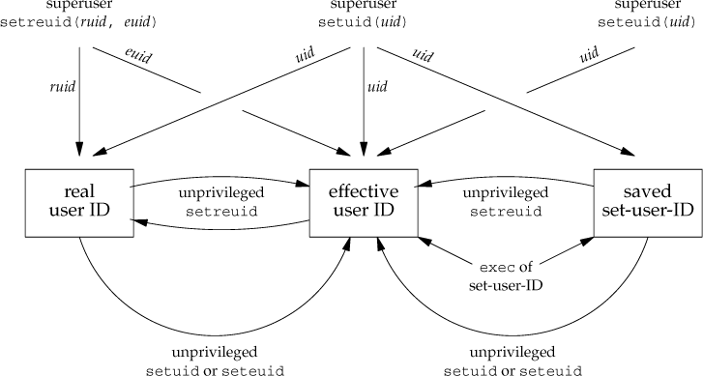

Slide 8
system FUNCTION
If cmdstring is a null pointer, system returns nonzero only if a command processor is available. This feature determines whether the system function is supported on a given operating system. Under the UNIX System, system is always available.
Because system is implemented by calling fork, exec, and waitpid, there are three types of return values.
If either the fork fails or waitpid returns an error other than EINTR, system returns 1 with errno set to indicate the error.
If the exec fails, implying that the shell can't be executed, the return value is as if the shell had executed exit(127).
Otherwise, all three functions fork, exec, and waitpid succeed, and the return value from system is the termination status of the shell, in the format specified for waitpid.

